Slide 1

Website Design Proposal
Presentation - Real estate
- Vedantic technologies

Slide 2
TABLE of CONTENTS
Executive Summary
Proposed Solution
Scope Of Work
Timeline
Expenditure
Contact
Visual Design Inspiration

Slide 3

Executive Summary
In today's competitive real estate market, having a modern, user-friendly website is essential for capturing leads, showcasing properties, and standing out against competitors. After reviewing your current website, we have identified several areas for improvement:
Limited Mobile Responsiveness – The site does not perform well on mobile devices, leading to potential missed leads from mobile users.
Slow Load Speed – This negatively impacts user experience and SEO ranking, reducing organic traffic.
Lack of Conversion Features – There is no direct arrangement for capturing inquiries from potential buyers or renters.
Outdated Design – The design is not competitive with real estate websites like 99acres, housing.com and maakan, etc making it harder to attract modern, tech-savvy customers.

Slide 4

Proposed Solution
We propose a modern, mobile-optimized, and SEO-friendly real estate website that will include features designed to increase your conversion rate by 50%. By focusing on the latest web technologies, our solution will help you attract more customers, improve your brand presence, and drive more property inquiries.
A Mobile Responsive design to ensure a seamless experience across all devices.
Lead Capture Forms and interactive property listings that encourage user engagement
Fast load speeds using optimazed images & coding techniques.
An Integrated CRM Systems to manage inquiries & property listings efficiently
SEO Optimization to rank higher in local search results, driving more organic traffic.

Slide 5
Scope of Work
The project will include the following deliverables:
Custom Real Estate Website Design
Aesthetically appealing and user-friendly interface.
Responsive design for mobile, tablet, and desktop.
Property Listings System
Custom property listing pages with filters, search functionality, and high-resolution images.
Integrated property inquiry forms.
Lead Generation Features
Customizable contact forms on property listings.
Newsletter sign-ups and CTA buttons to increase lead collection.
Content Management System (CMS)
Easy-to-use back-end interface for adding/removing properties, changing prices, and updating content.
SEO Optimization
Keyword research and on-page SEO to help your listings rank in search engines.
Analytics Integration
Google Analytics and Facebook Pixel setup for tracking user interactions and conversions.

Slide 6
Timeline
Time-Line For Website
Project Stage | Estimated Timeframe
Project Planning & Design Phase | 1 Week
Development Phase | 2 - 3 Weeks
Testing & Review | 1 Week
Final Launch | 2 - 3 days
*Note : This Time line is tentative may be changed

Slide 7
Expenditure
Total Cost - Annual
Service | Cost
Website Design & Development | 12,000
SEO Optimization & CMS Setup | 10,000
Monthly Maintenance (Annual ) | 13,000
Final Launch - Total | 35,000
Payment Process
Initial Pay :- 30%
Post Development :- 40%
Delivery : 30%

Slide 8

Contact
https://vedantictechnologies.com/
Name : Vinod Mokashi
Number : +91 7841025607
Email : sales@vedantictechnologies.com
Company : Vedantic Technologies
Country : India

Slide 9
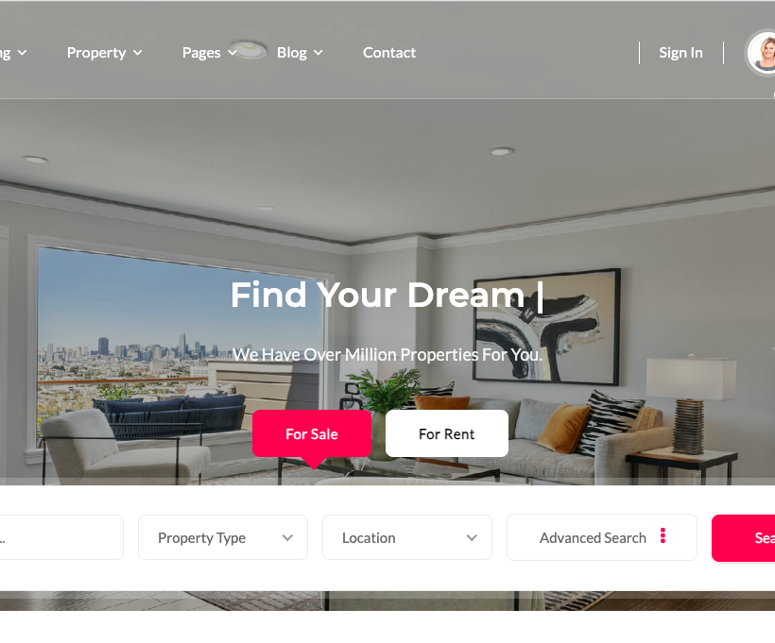
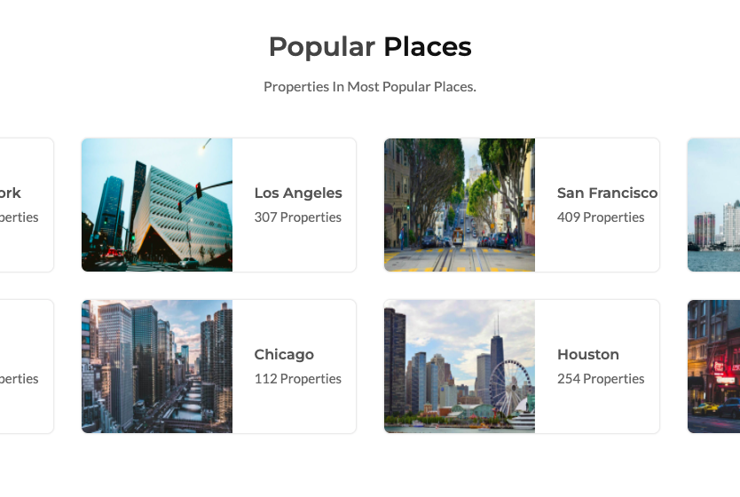
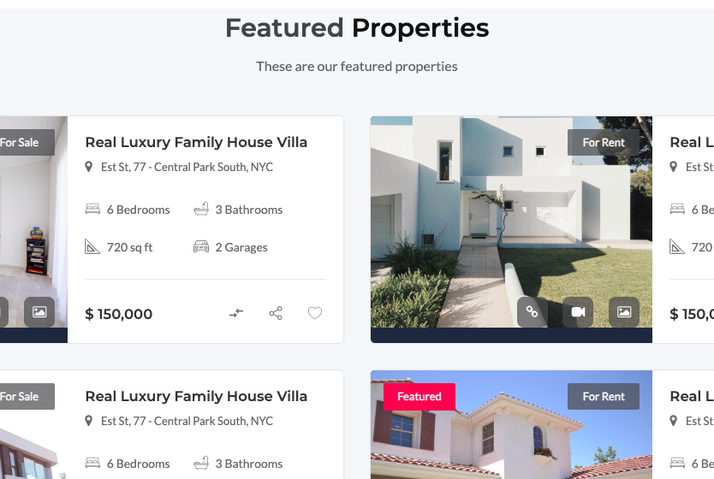

Slide 10
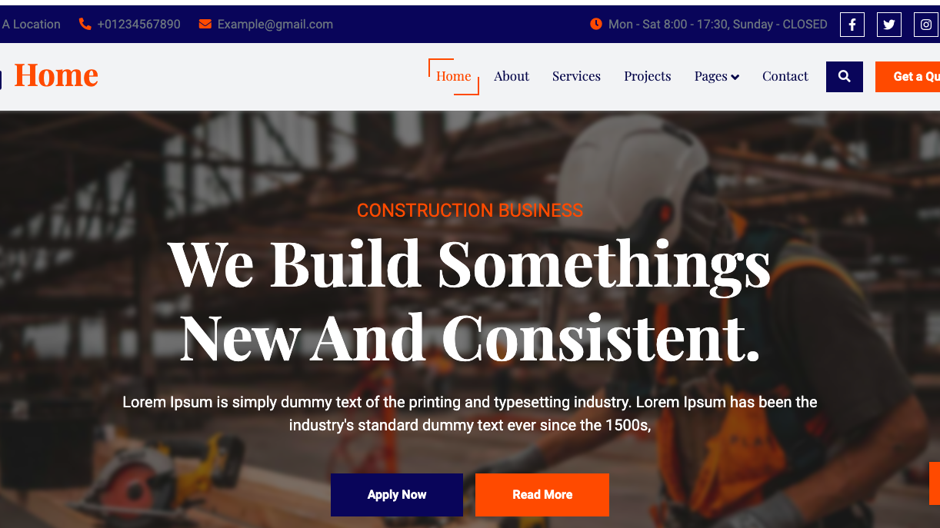

Slide 11
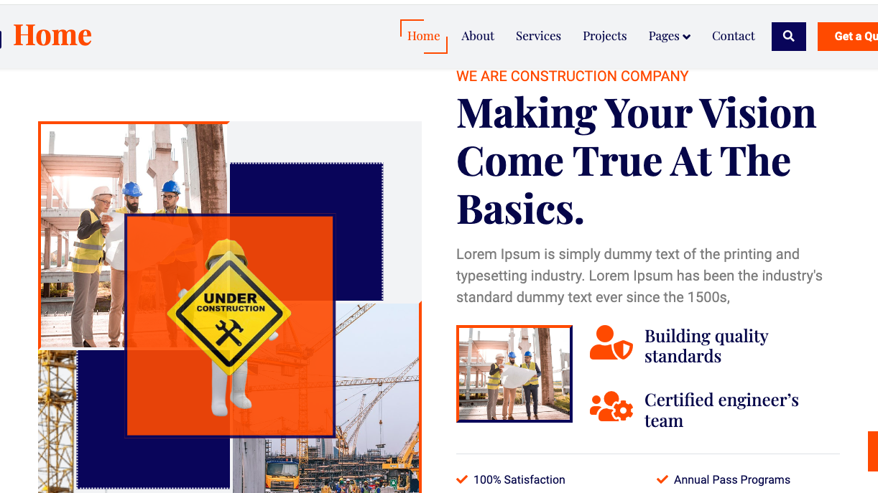

Slide 12
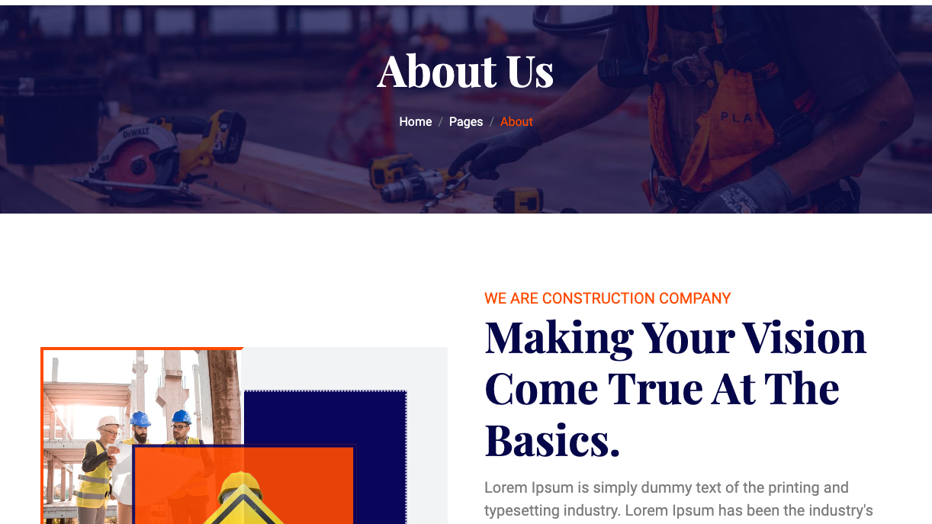

Slide 13
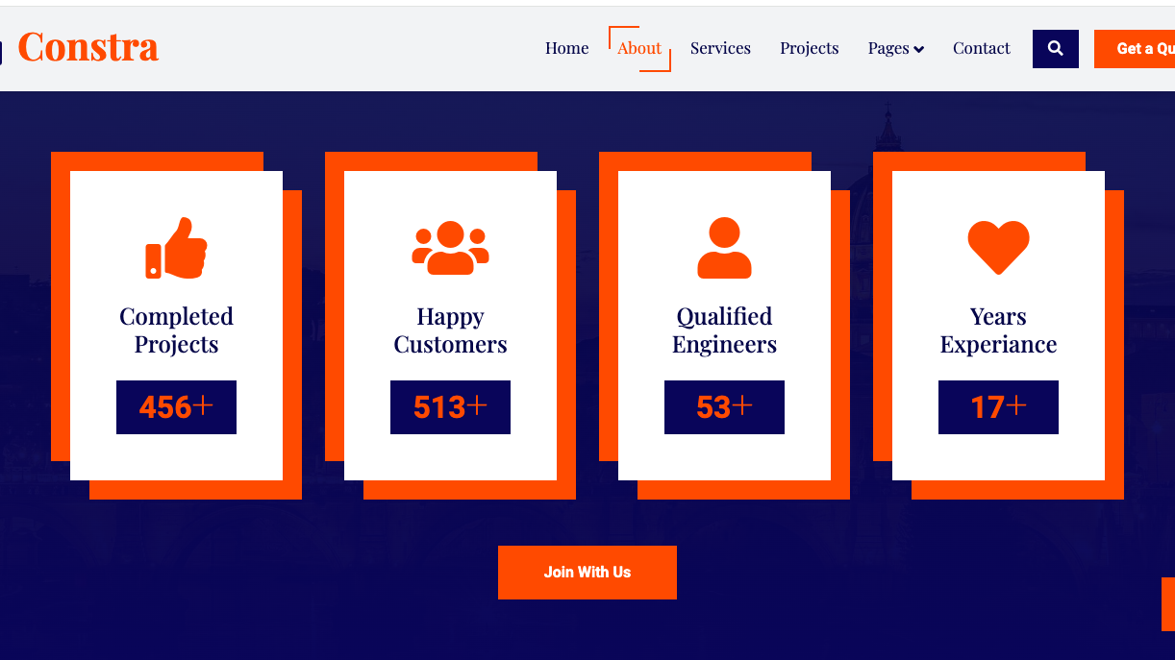

Slide 14

Vedantic Technologies

